Slide 1
Class Check Attendance
Members:
Ngô Thúc Đạt
Hồ Trọng Đức
Nguyễn Hồng Quý
Hà Nội, 04 Jan 2018

Slide 2
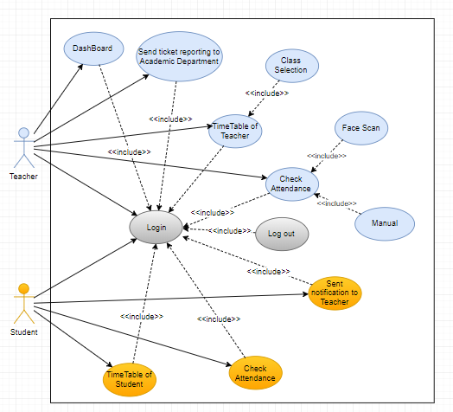
Use Case Diagram

Slide 3
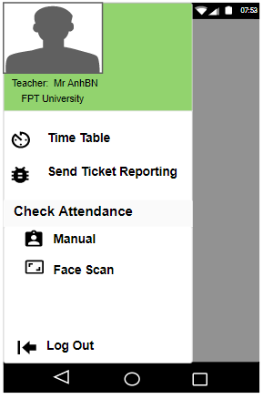
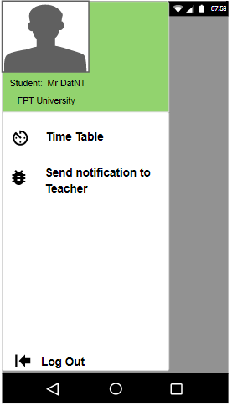
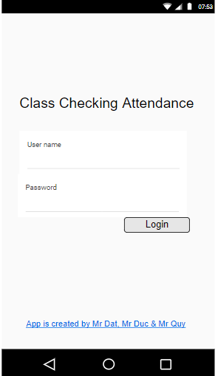
Use-case : UC_01 Login
Login successful

Slide 4
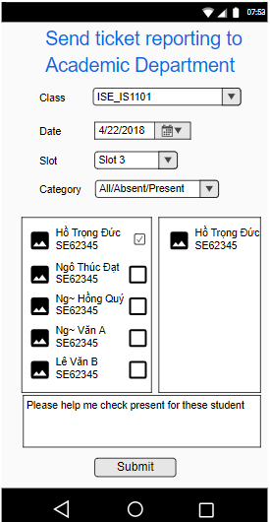
UI - Send ticket reporting
Academic
department

Slide 5
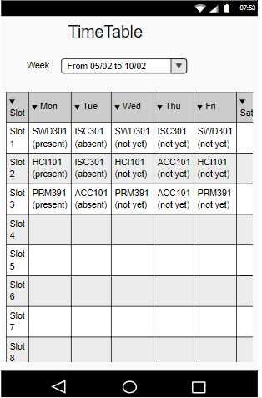
Time Table of Teacher / Student

